Slide 1
LEARNING FROM LAS VEGAS
Lecture 5 of 12
by Dr. Loren Lerner, Department of Art History, Concordia University, Montreal
Special thanks to Serena Desaulniers, editing and technical assistant

Slide 2
Learning from Las Vegas | OUTLINE
TOM WOLFE
REYNER BANHAM
ROBERT VENTURI AND DENISE SCOTT BROWN, LEARNING FROM LAS VEGAS, 1972
In the words of Denise Scott Brown
The Meanings of Architectural Forms
Venturi, Scott Brown, and Josh Rauch, Buildings Reflecting Learning from Las Vegas
Learning from Las Vegas and Pop Artists

Slide 3
Tom Wolfe

Slide 4
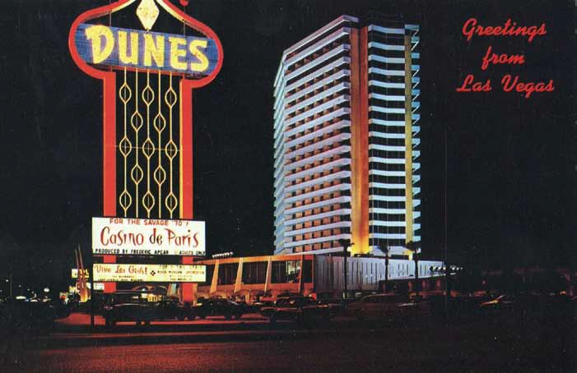
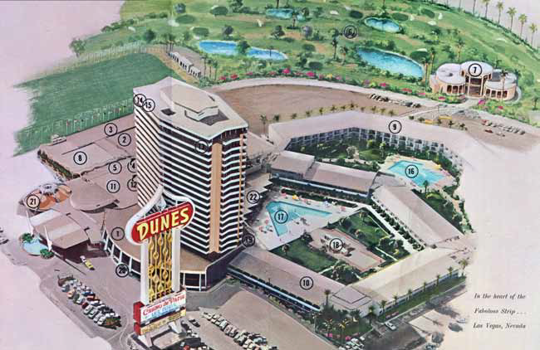
The 180-foot Dunes sign started the Pop City era, or the "Golden Age of the Sign" The Dunes sign was erected in 1964.
Notes:
.

Slide 5
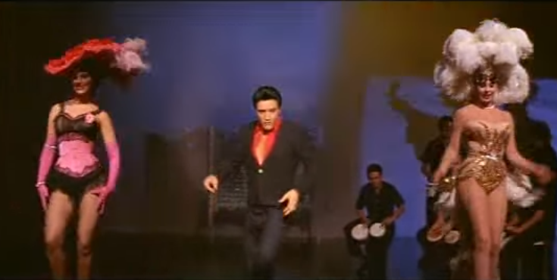
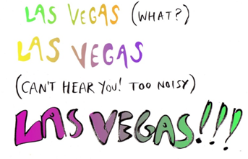
Elvis Presley’s Viva Las Vegas
That same year saw Elvis’s Viva Las Vegas come out in cinemas and the publishing of Tom Wolfe’s seminal essay, "Las Vegas (What?) Las Vegas (Can't hear you! Too noisy) Las Vegas!!!!" in Esquire magazine. While Elvis added to the popularization of Las Vegas among the masses, Tom Wolfe who developed a "new journalism" that popularized Las Vegas among the cultural critics.
Tom Wolfe

Slide 6
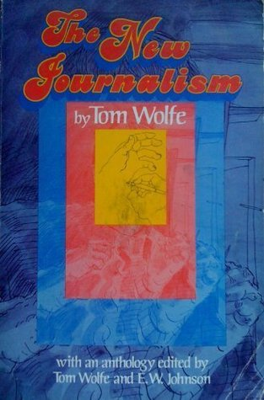
New journalism according to Tom Wolfe did not conform to the objective standards of journalism but rather incorporated literary devices usually only found in fictional works.
(Harper and Row, a 1973 anthology edited by Tom Wolfe and E. W. Johnson)

Slide 7
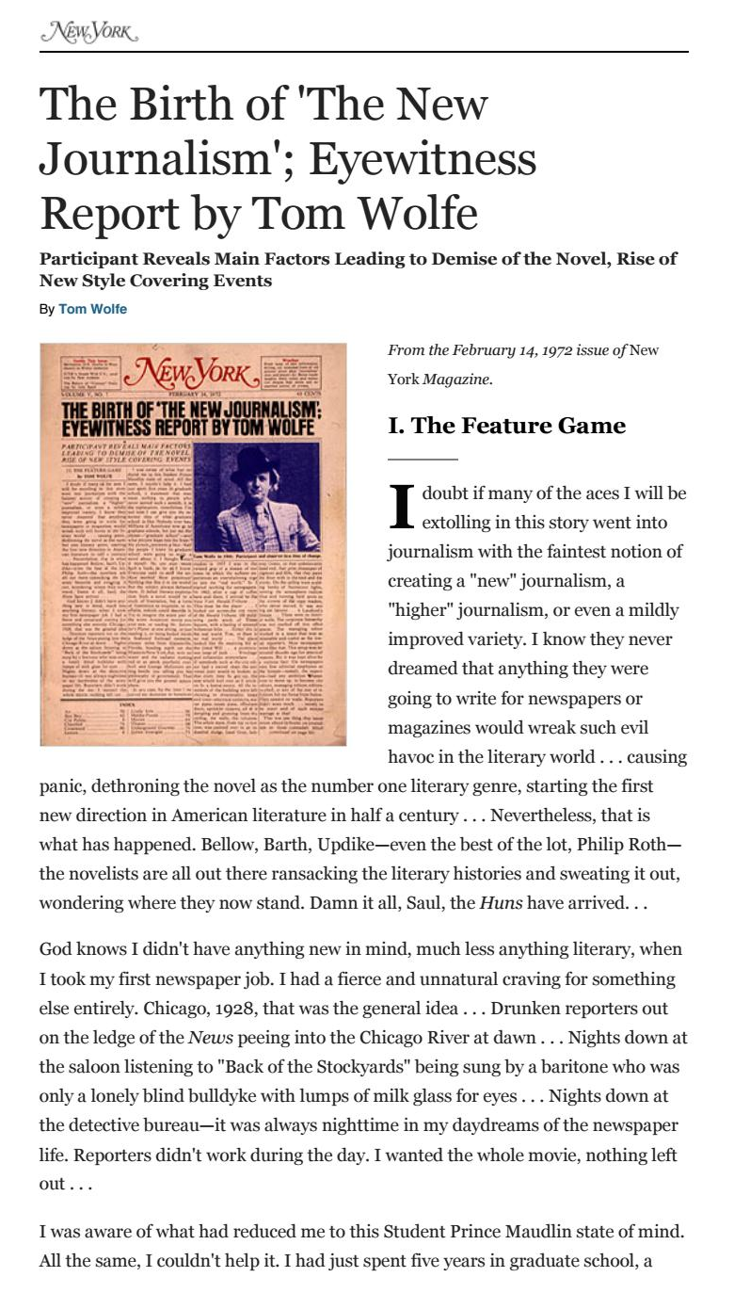
Tom Wolfe writes in an essay first published in February 14, 1972 issue of New York Magazine as "The Birth of 'The New Journalism': An Eyewitness Report" and reprinted in The New Journalism.
"And yet in the early 1960s a curious new notion, just hot enough to inflame the ego, had begun to intrude into the tiny confines of the feature statusphere. It was in the nature of a discovery. This discovery, modest at first, humble, in fact, deferential, you might say, was that it just might be possible to write journalism that would...read like a novel. Like a novel, if you get the picture. This was the sincerest form of homage to The Novel and to those greats, the novelists, of course. Not even the journalists who pioneered in this direction doubted for a moment that the novelist was the reigning literary artist, now and forever."

Slide 8
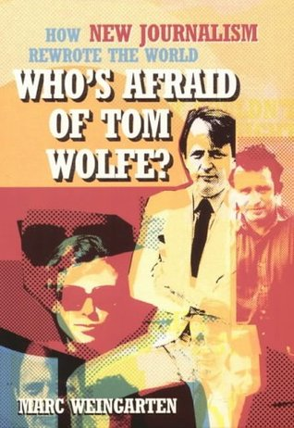
"All they were asking for was the privilege of dressing up like him...until the day when they themselves would work up their nerve and go into the shack and try it for real...They were dreamers, all right, but one thing they never dreamed of. They never dreamed of the approaching irony. They never guessed for a minute that the work they would do over the next ten years, as journalists, would wipe out the novel as literature’s main event."
(Autum Press, 2005)

Slide 9
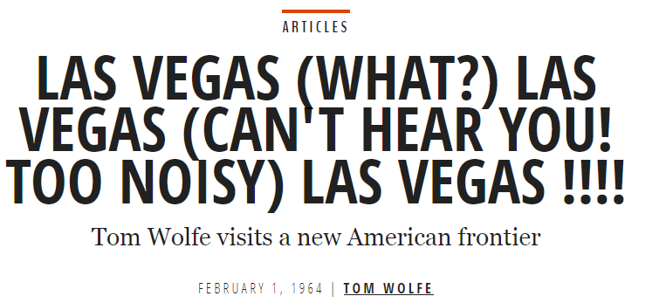
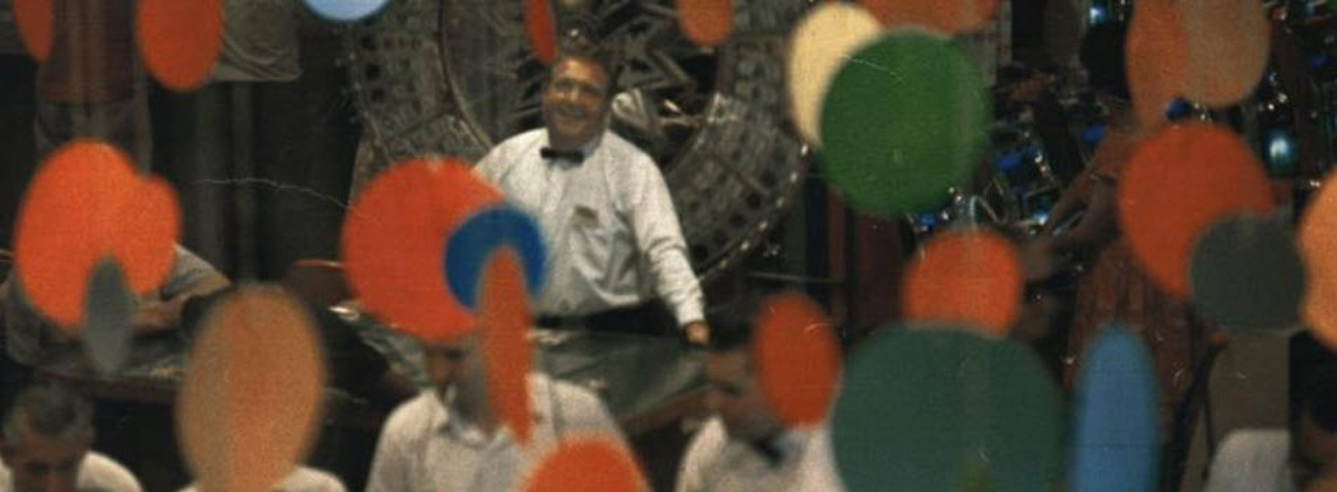
Wolfe’s essay on Las Vegas shook up the cultural establishment, especially since, at that time, architectural and urban theorists thought very little of the town.

Slide 10
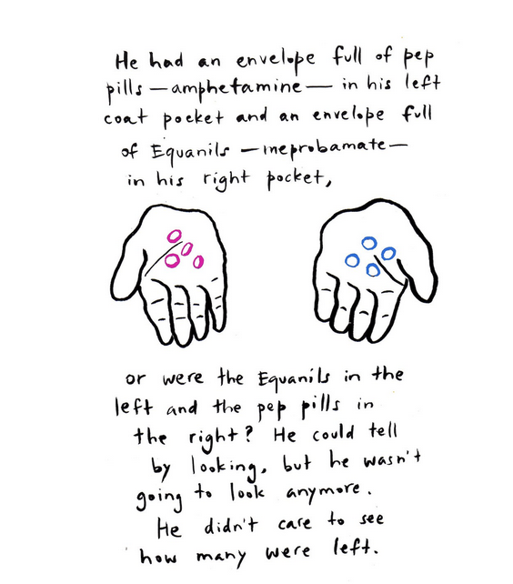
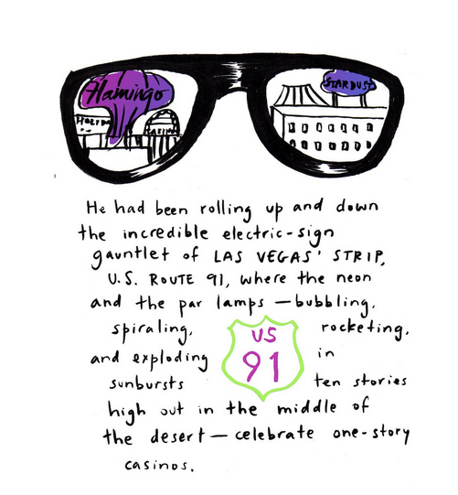
The orgy that launches Tom Wolfe's story purports to quote a 34-year-old engineer from Phoenix named Raymond at a craps table of an unidentified casino making fun at 3:45 on a Sunday morning of the droning sing-song patter of the dealer. The dealer gets him escorted from the house by security guards who Raymond, gambling round the clock for several days, greets by asking, "How’s your old Cosa Nostra?" This was still the era of mob control of the Strip.

Slide 11
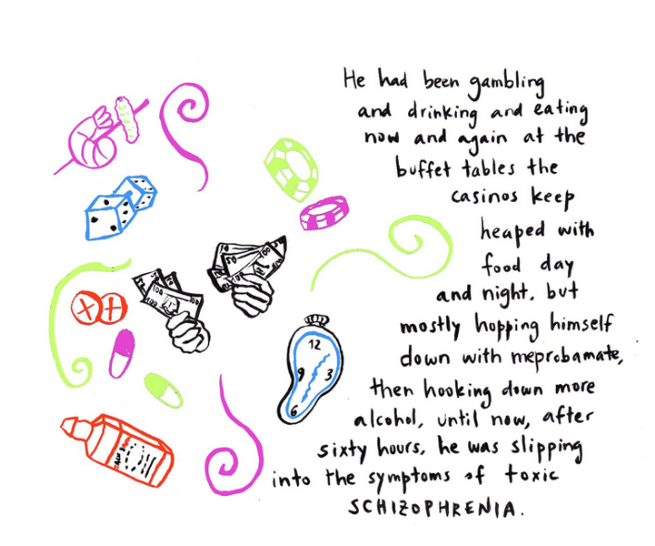
Tom Wolfe theoretically "discovered" Las Vegas, delineating most of the architectural and urban theorists’ future topics of inquiry: Las Vegas as a vernacular pop city designed by the "prole," and as an exciting technologically wired, but exploitative, psychedelic distortion of reality.

Slide 12
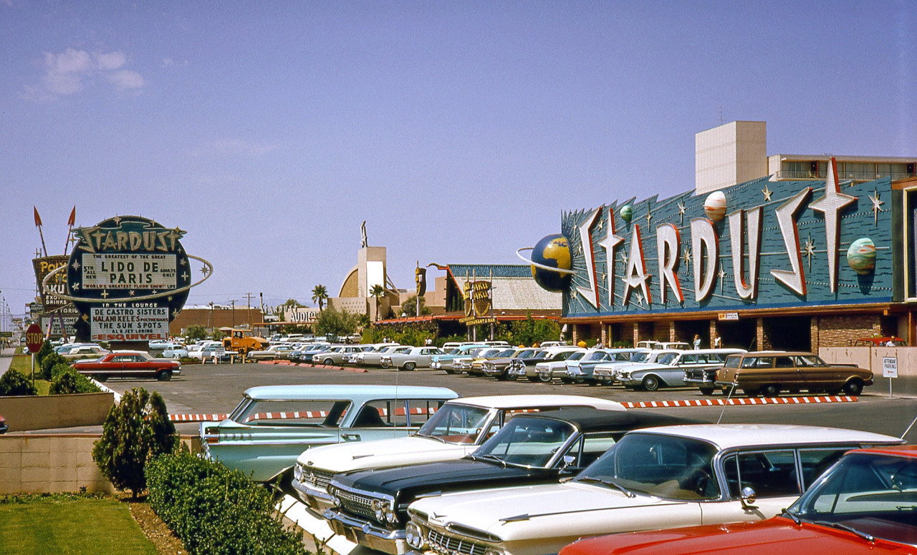
Tom Wolfe, Esquire 1964: "The important thing about Las Vegas is not that the builders were gangsters but proles... Because it is prole, it gets ignored, except on the most sensational level. Yet long after Las Vegas' influence as a gambling heaven has gone, Las Vegas' forms and symbols will be influencing American life."

Slide 13
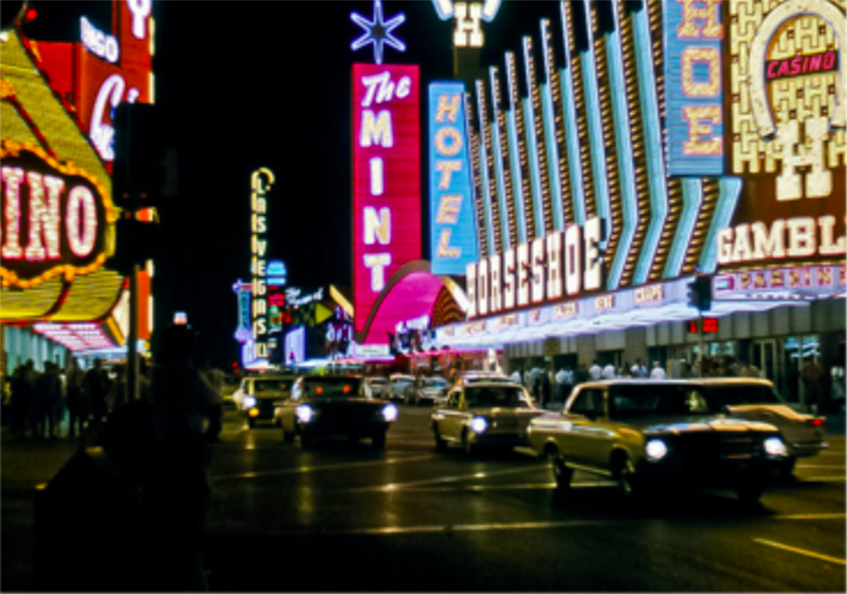
"That fantastic skyline! Las Vegas's neon sculpture, it's fantastic fifteen-story-high display signs (parabolas, boomerangs, rhomboids, trapezoids, and all the rest of it), are already the staple design of the American landscape outside the oldest parts of the oldest cities. They are all over every suburb, every subdivision, every highway."

Slide 14
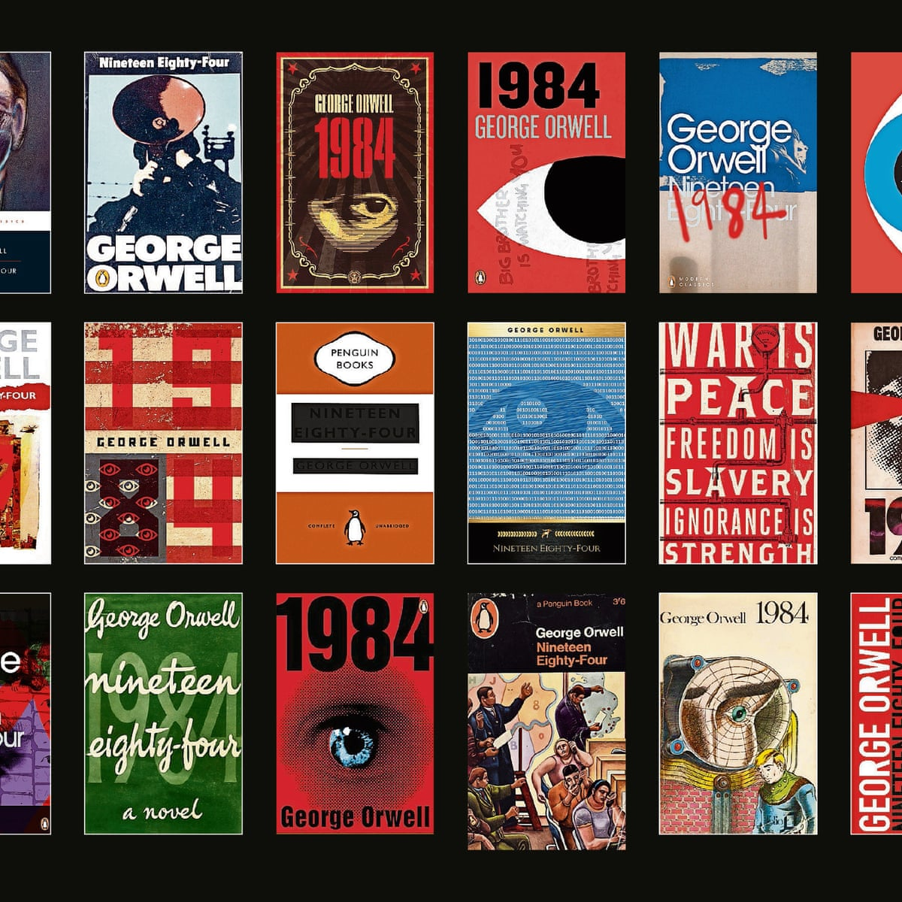
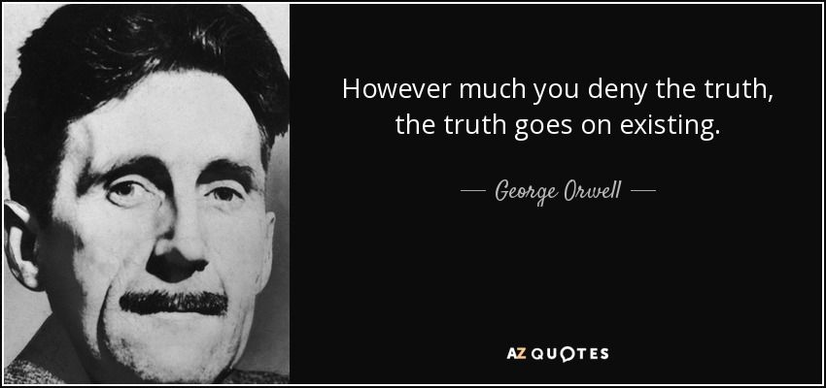
The word prole is a shortening of the word proletarian, a term for the working class. The word was made popular by George Orwell in his 1949 novel Nineteen Eighty-Four, in which he uses the word proles (collective noun) to refer to the working class of Oceania (i.e. the proletariat). Orwell's society in 1984 is made up of 3 classes: the Inner Party, the Outer Party, and the proles. The slogan of the Party concerning this 3rd reject class is that "Proles and animals are free." Their only purpose in society is to work and breed. The proles are kept "happy" by lotteries, silly songs, and pornography. Winston reveals later in the novel, that "if there is hope, it lies with the proles" because he feels they are the only ones who have kept their individuality and humanity. Sadly, Winstron soon learns that the prole will never revolt because they have all they need from life—food, shelter, "entertainment."
(First published Secker and Warburg, 1949)
Notes:
(Secker and Warburg, 1949)

Slide 15
Wolfe describes a Vegas before high-rise buildings. "Las Vegas is the only town in the world whose skyline is made up neither of buildings, like New York, nor of trees, like Wilbraham, Massachusetts, but signs," he writes. "One can look at Las Vegas from a mile away on Route 91 [Las Vegas Blvd., a/k/a The Strip] and see no buildings, no trees, only signs. But such signs! They tower. The revolve, they oscillate, they soar in shapes before which the existing vocabulary of art history is helpless."

Slide 16
Wolfe interviewed sign designers of YESCO. When asking one of the designers how he called a particular shape of a sign Wolfe had seen on the Strip, the designer’s answer, "Well, that’s what we call—what we sort of call—'free form'," exhilarated him: "Free form! Marvellous! No hung- up old art history words for these guys. America’s first unconscious avant-garde! The hell with Mondrian whoever the hell he is. The hell with Moholy-Nagy, if anybody ever heard of him. Artists for the new age; sculptors for the new style…"

Slide 17
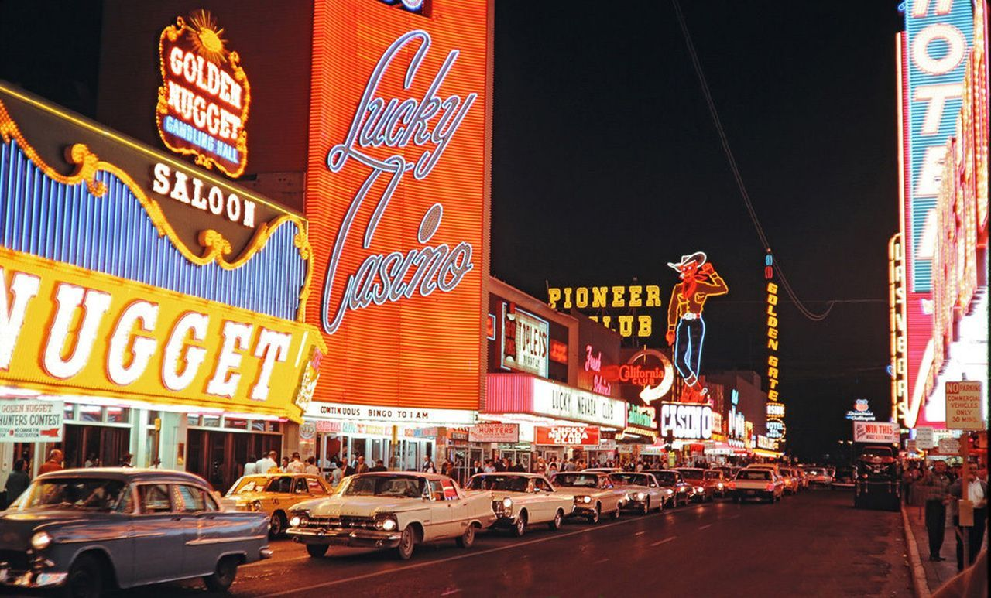
It was precisely because "the designer-sculptor geniuses of Las Vegas" were "prole," that their influence was so large. The architecture of Las Vegas was designed by, and for the people, so was the argument. This is why their style was successful and repeated throughout the entire city. "Men [of YESCO] like Boernge, Kermit Wayne, Ben Mitchem and Jack Larsen, formerly an artist for Walt Disney, are the designer-sculptor geniuses of Las Vegas, but their motifs have been carried faithfully throughout the town by lesser men, for gasoline stations, motels, funeral parlors, churches, public buildings, flophouses and sauna baths."

Slide 18
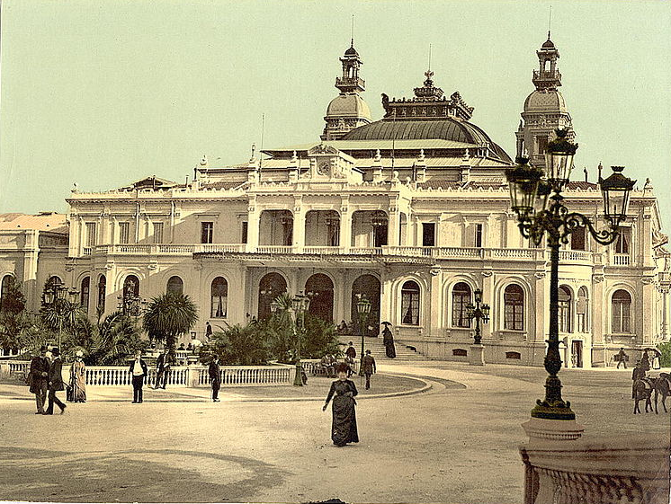
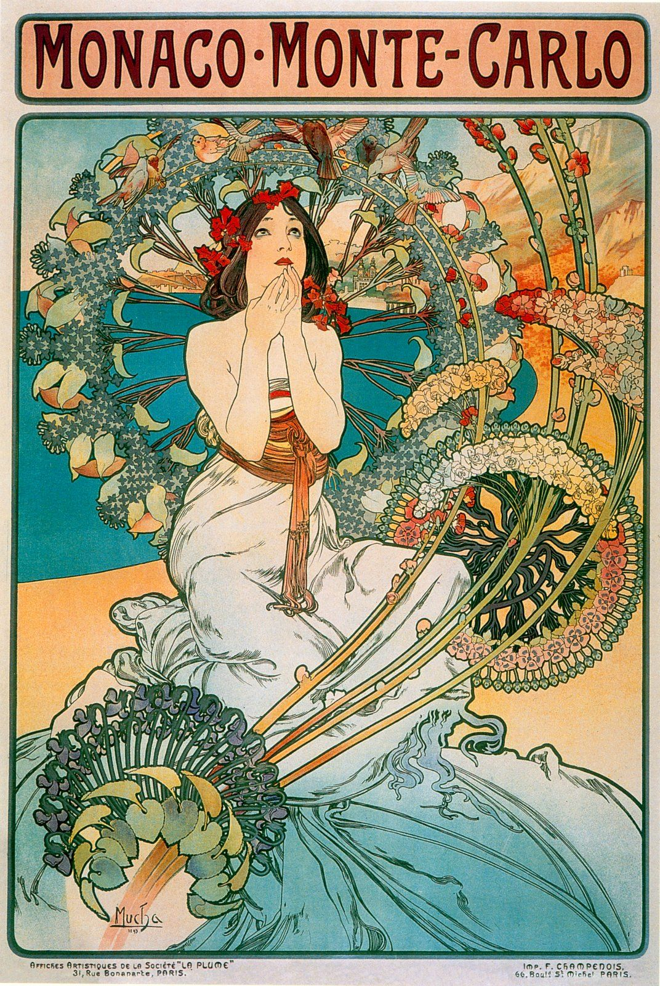
Jules Dutrou and Charles Garnier, Place du Casino, Monte Carlo, after the expansion of 1878–79.
Alphonse Mucha, Monte Carlo poster, 1897.
For Wolfe, Las Vegas embodied the new symbolic cultural high point of the people, a counter to the aristocratic class, an "American Monte Carlo" that effaces the distinction between 'good' and "bad" taste. "Las Vegas has become, just as Bugsy Siegel dreamed, the American Monte Carlo—without any of the inevitable upper-class baggage of the Riviera casinos."

Slide 19
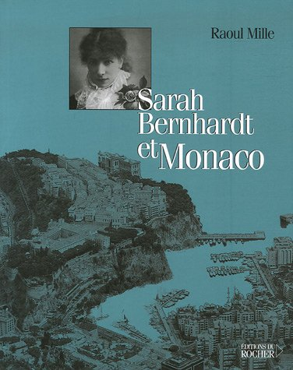
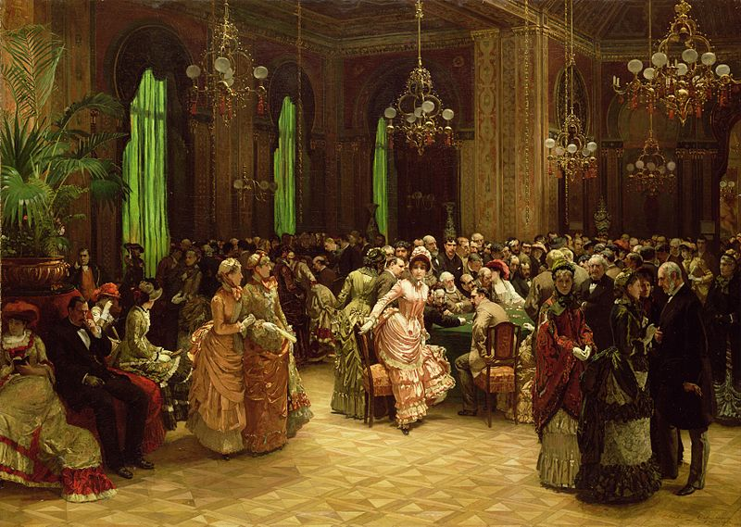
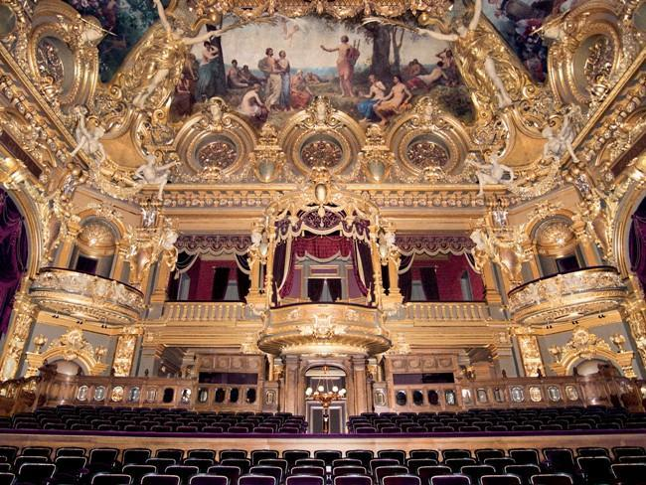
Christian L. Bokelmann, Das Casino, Monte Carlo,1884.
(Du Rocher, 2006)
"At Monte Carlo, Monaco there is still the plush mustiness of the nineteenth century noble lions ... There are still Wrong Forks, Deficient Accents, Poor Tailoring, Gauche Displays, Nouveau Richness, Cultural Aridity—concepts unknown in Las Vegas. For the grand debut of Monte Carlo as a resort in 1879 the architect Charles Garnier designed an opera house for the Place du Casino; and Sarah Bernhardt read a symbolic poem."
Charles Garnier, Salle Garnier, home of the Opéra de Monte-Carlo, 1879.

Slide 20
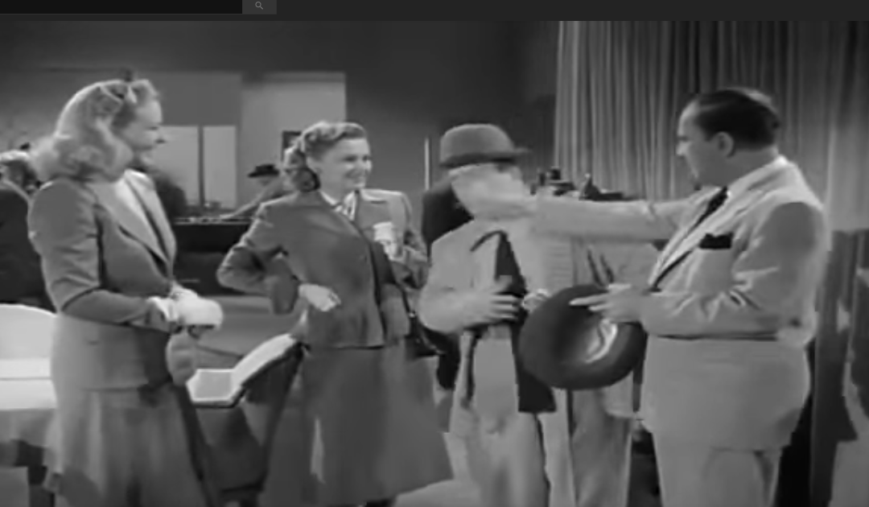
"For the debut of Las Vegas as a resort in 1946 Bugsy Siegel hired Abbot and Costello, and there, in a way, you have it all." An American comedic duo who performed onstage, in films, and on radio and television. Bud Abbott (original name William Alexander Abbott) and Lou Costello (original name Louis Francis Cristillo) specialized in rapid-fire patter and knockabout slapstick. They are regarded as the archetypal team of burlesque comedy.
Abbott And Costello Show, Las Vegas.

Slide 21
REYNER BANHAM

Slide 22
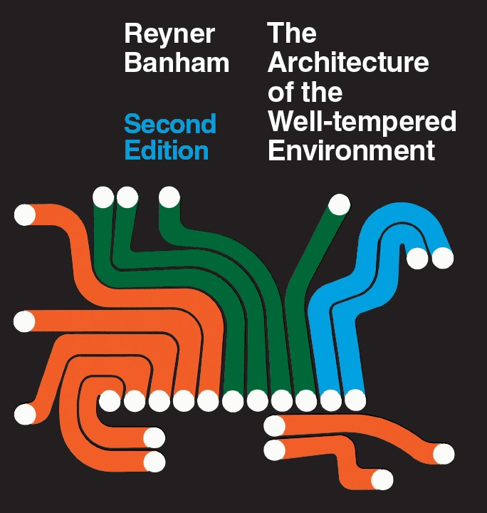
Reyner Banham was one of the most influential writers on architecture, design, and popular culture from the mid-1950s to the late 1980s. Trained in mechanical engineering and art history, he was convinced that technology was making society not only more exciting but more democratic. His combination of academic rigor and pop culture sensibility put him in opposition to both traditionalists and orthodox Modernists, but placed him in a unique position to understand the cultural, social, and political implications of the visual arts in the postwar period.
(London Architectural Press, 1969)

Slide 23
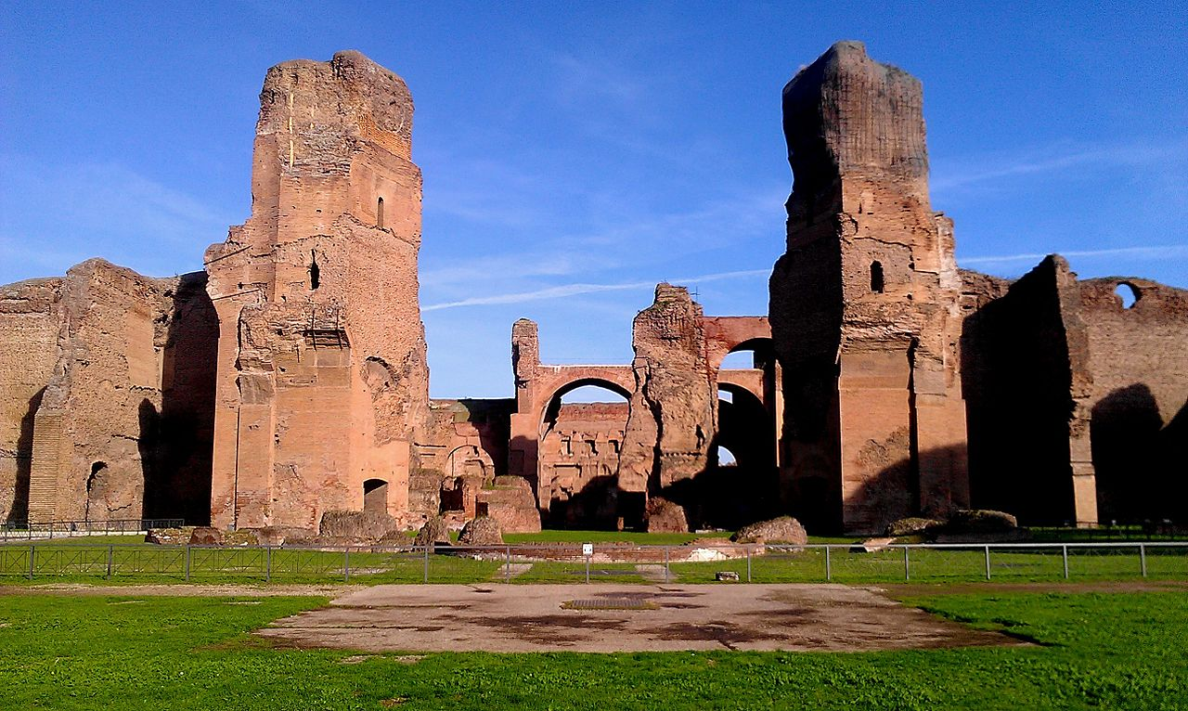
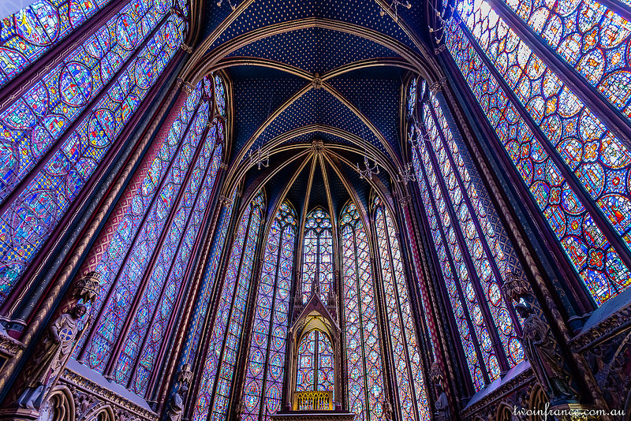
Banham writes: "a visit to Las Vegas would be as mandatory as a visit to the Baths of Caracalla or La Sainte Chapelle." As far as he was concerned the "point of studying Las Vegas, ultimately would be to see an example of how far environmental technology can be driven beyond the confines of architectural practice by designers who (for better or worse) are not inhibited by the traditions of architectonic culture, training and taste."
The Baths of Caracalla, ca. AD 212 (or 211) and 216/217.
Sainte-Chapelle is a royal chapel in the Gothic style, 1238-1248.

Slide 24
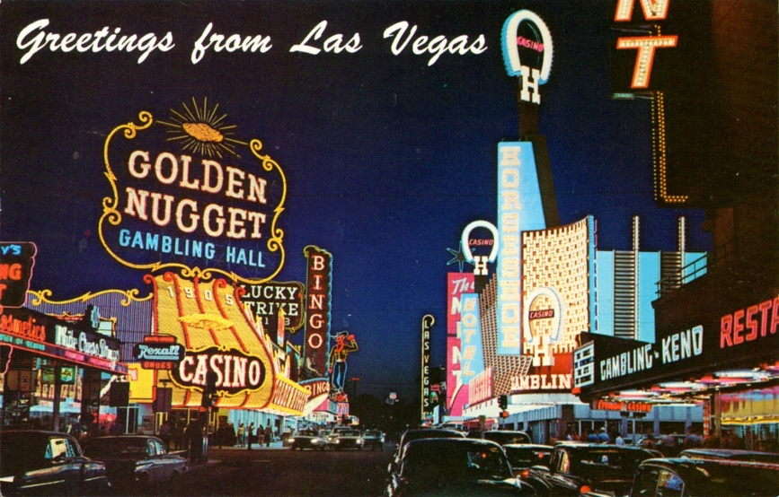
Banham wittily and perceptively defines Las Vegas as representing a "… change from forms assembled in light to light assembled in forms...—another version of formlessness, if not tastelessness... What defines the symbolic spaces and places of Las Vegas—the superhotels of The Strip, the casino-belt of Fremont Street—is pure environmental power, manifested as colored light.... [T]he fact remains that the effectiveness with which space is defined is overwhelming, the creation of virtual volumes without apparent structure is endemic, the variety and ingenuity of the lighting techniques is encyclopaedic..."

Slide 25
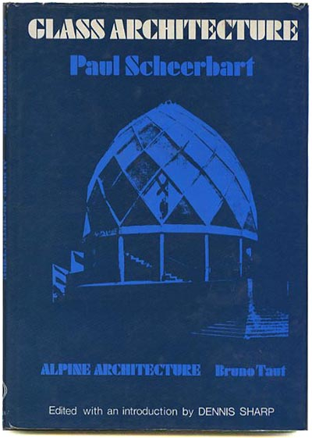
Banham’s reference to "colored light" recalls the visionary architecture of Paul Scheerbart and his 1914 book Glass Architecture (Glasarchitektur) with its call for "more colored light!" Scheerbart foretold of a sublime, technocratic civilization whose peaceful world-order was borne from the proliferation of crystal cities and floating continents of chromatic glass, a vision summed up in his aphorism: "Colored glass destroys all hatred at last." Banham links Scheerbart and Las Vegas directly: the nightscape of the city, he suggests, is an example of what Scheerbart was prophesizing and had "come true in oblique ways he could never have anticipated..."
(New York: Praeger, 1972, original publication, 1914)

Slide 26
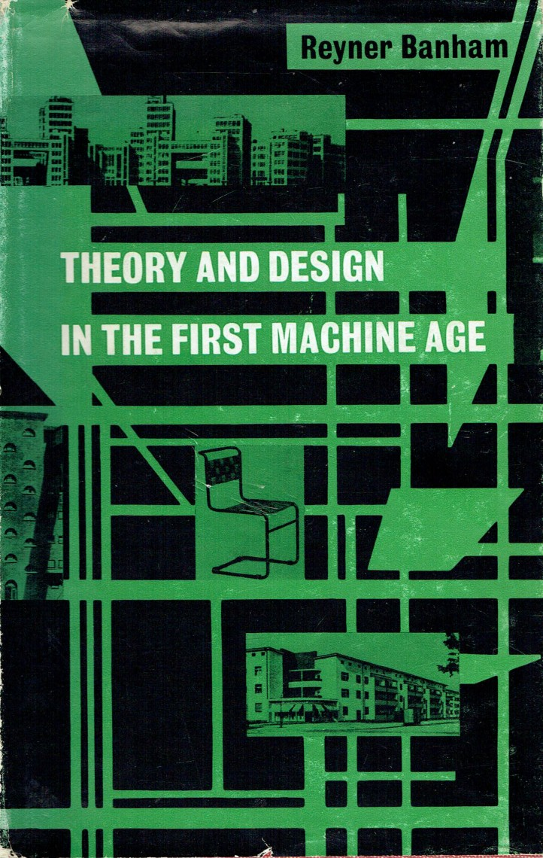
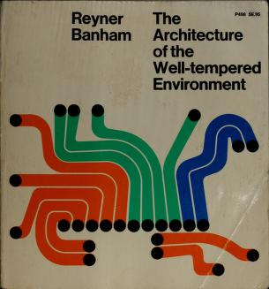
(MIT Press, 1960)
(First published, Architectural Press, 1969)
Scheerbart had been one of the prophets rediscovered by Banham in Theory and Design in the First Machine Age, and his stature remained high in The Architecture of the Well-tempered Environment.
Notes:
(First published, Architectural Press, 1969)

Slide 27
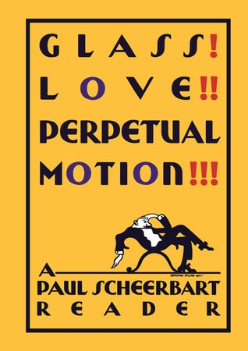
Scheerbart wrote: "We live for the most part in closed rooms. These form the environment from which our culture grows. Our culture is to a certain extent the product of our architecture. If we want our culture to rise to a higher level, we are obliged, for better or for worse, to change our architecture. And this only becomes possible if we take away the closed character from the rooms in which we live. We can only do that by introducing glass architecture, which lets in the lights of the sun, the moon, and the stars, nor merely through a few windows, but through every possible wall, which will be made entirely of glass–of coloured glass. The new environment, which we thus create, must bring us a new culture." (p. 26)
(2014)

Slide 28
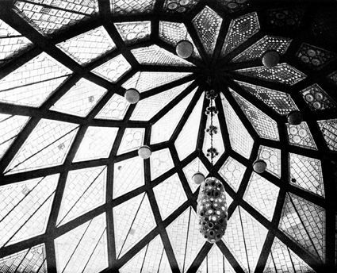
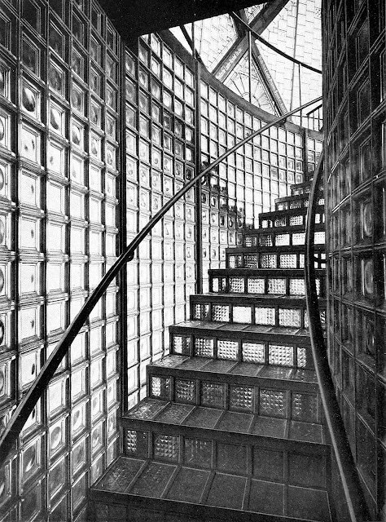
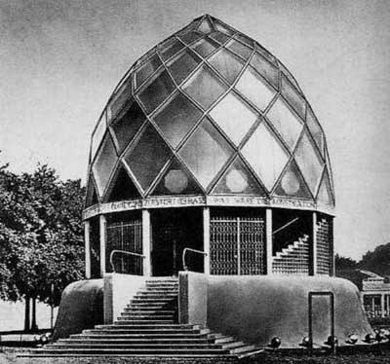
Bruno Taut, a prolific German architect, urban planner during the Weimar period shared Scheerbart's viewpoint: "The Glass House has no purpose other than to be beautiful. It is intended purely as a structure for exhibition and should be a beautiful source of ideas for 'lasting' architecture but is not itself intended as such. According to Paul Scheerbart, to whom it is dedicated, the Glass House should inspire the dissolution of current architecture’s far-too- restricted understanding of space and should introduce the effects and possibilities of glass into the world of architecture. May it, in its own way, help to foster a transformation of building toward the light and grace that it currently sorely lacks."

Slide 29
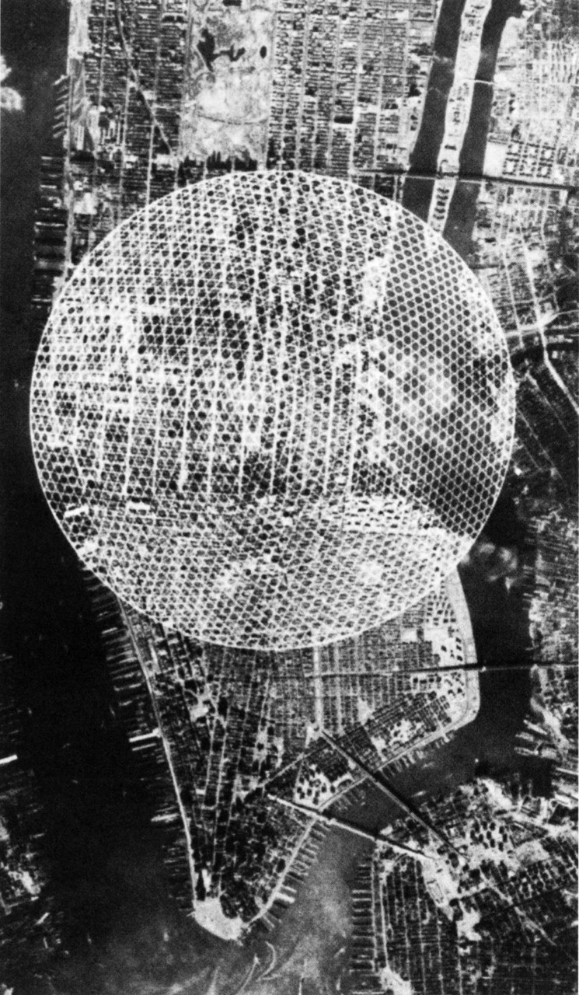
Banham was an alternative Modernist who challenged orthodoxies and offered a vision of a technologically-based architecture, underpinned by a keen "mechanical sensibility." His commitment to the "mechanical sensibility" and the "technological century" also led Banham to champion architects such as Buckminster Fuller. Banham recognized the fundamental nature of Buckminister Fuller's claims.
R. Buckminster Fuller and Shoji Sadao, Dome over Manhattan, 1960.

Slide 30
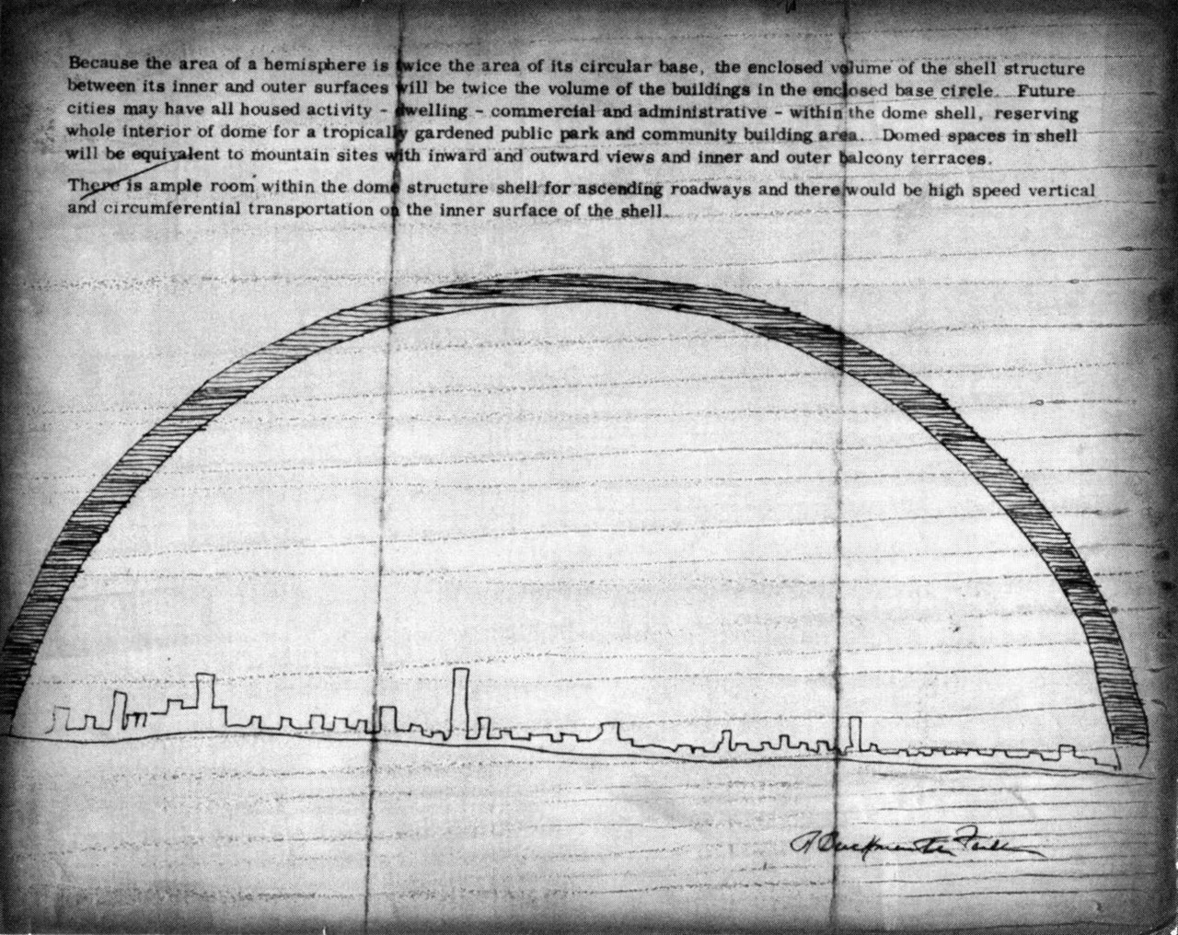
R. Buckminster Fuller’s radical proposal to envelop midtown Manhattan under a two-mile diameter hemispherical geodesic dome is often dismissed as an unserious imaginary proposition from a mad scientist or a purely hypothetical critical provocation. To do so is to dramatically underestimate the deeply practical grandeur of Fuller’s mind. Fuller posited his unique blend of geodesic mathematics and material science as a fundamental advancement in the human technomaterial capacity. When one is constantly considering issues of energy consumption and resource allocation on a global scale, two spherical miles is no longer an unreasonable scale, but rather a logical stepping stone toward massive reduction in energy use by systematically deploying technologies to temper the environment.
R. Buckminster Fuller, Dome over Manhattan, sketch, 1960.

Slide 31
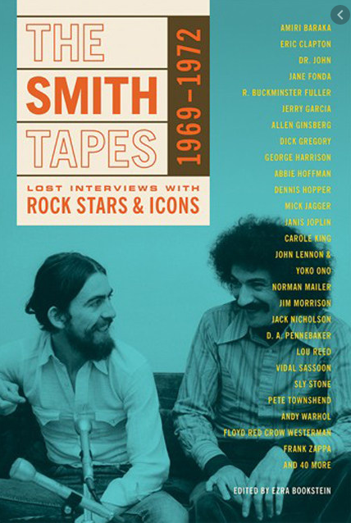
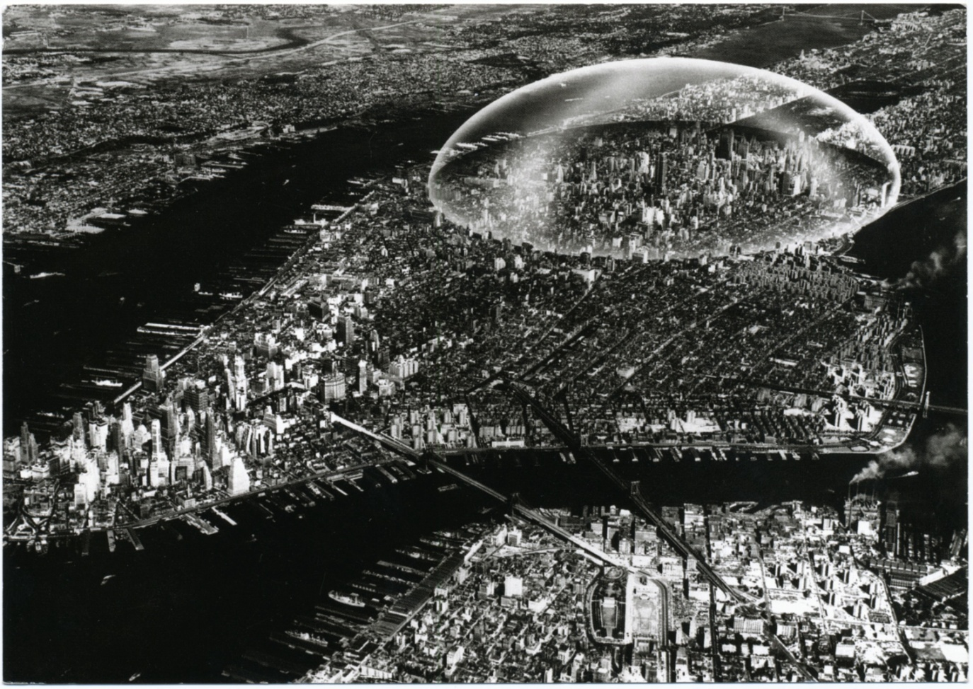
(Chronicle Books, 2015)
R. Buckminster Fuller and Shoji Sadao, Dome over Manhattan, 1960.
Fuller was deeply serious in this regard: "I then did the calculation of the amount of surfaces of the buildings in New York that are being covered by my dome in this theoretical superimposition of it. I found that the surface of buildings which stood below our dome were eighty times the surface of my dome. Which would mean that if you just had the covering out there, you’d reduce heat losses in New York eighty times. We would reduce down to about 20 percent of the amount of energy input you’d have to put in today" (Fuller, Smith, 323).

Slide 32
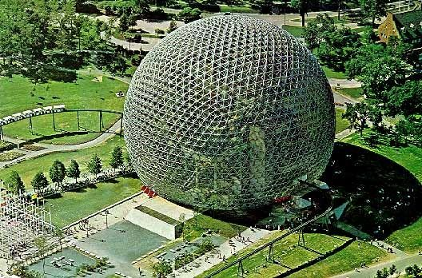
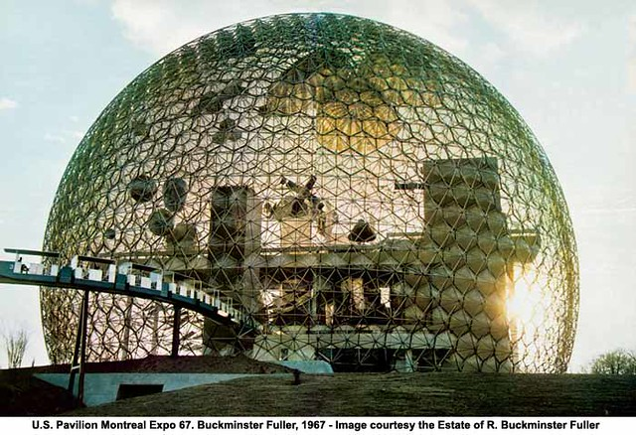
The theory checks out; the math works; the economy makes sense; yet midtown Manhattan has continued to remain domeless. As do the other sites of proposals to dome over cities—like the dome over Winooski, Vermont, a project Fuller did not propose, but was consulted publicly about to consider its feasibility of construction. In fact, Fuller’s geodesic dome system was never realized at any scale greater than a medium-to-large building as in the United States Pavilion for Expo 67 in Montreal.

Slide 33
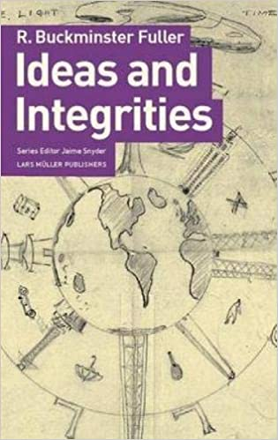
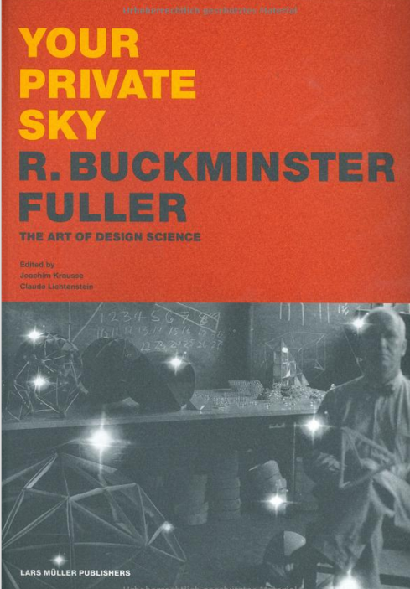
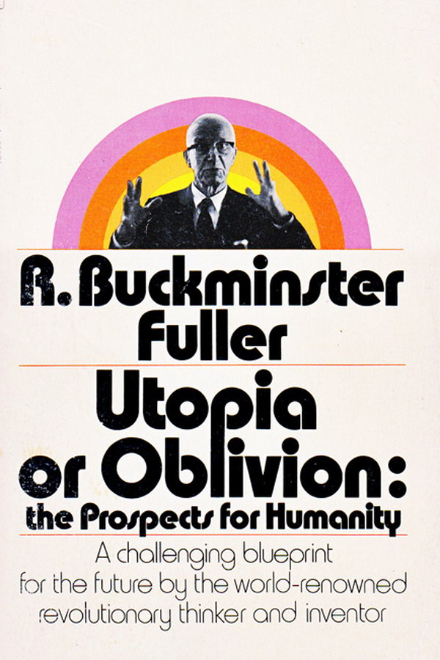
R. Buckminster Fuller was a 20th century inventor and visionary who did not limit himself to one field but worked as a "comprehensive anticipatory design scientist" to solve global problems. Fuller's ideas and work continue to influence new generations of designers, architects, scientists and artists working to create a sustainable planet.

Slide 34
Robert Venturi
and Denise Scott Brown,
Learning from Las Vegas, 1972

Slide 35
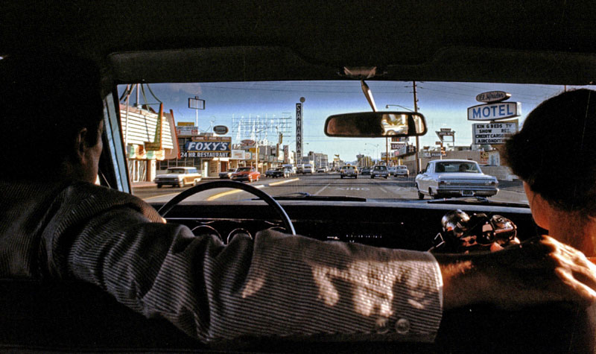
Robert Venturi and Denise Scott Brown approaching Las Vegas, 1968.

Slide 36
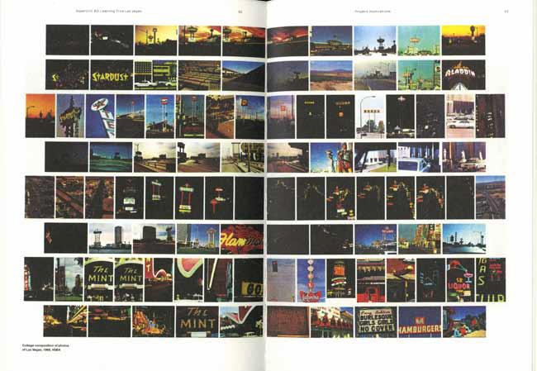
Venturi, Robert, Denise Scott Brown, and Steven Izenour. Learning from Las Vegas. Cambridge: MIT Press, 1977.
Venturi and Scott Brown wrote a seminal work that catapulted Las Vegas to the forefront of the discussion of postmodernism of architecture. The book, Learning From Las Vegas, published in 1972, was the outcome of a 10-day research expedition for an architecture studio in 1968. The studio was based on the essay "A Significance for A&P Parking Lots, or Learning from Las Vegas," which they had published in Architectural Forum in March 1968.

Slide 37
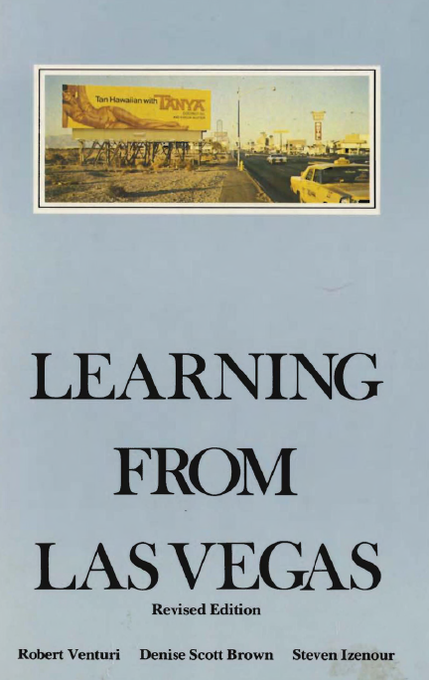
In the words of Scott Brown, the book Learning from Las Vegas is a "treatise on symbolism in architecture." Las Vegas is analyzed as a phenomenon of architectural communication. The 'Strip' is architecture of communication over space, achieved through style and signs. This is a unique condition in comparison to "enclosed space," which architects are more familiar with. The value of symbolism and allusion in architecture of vast space and speed are evidenced through the Strip. Hence, Las Vegas is not the subject of the book. The symbolism of architectural form is.
(Cambridge: MIT Press, 1977)

Slide 38
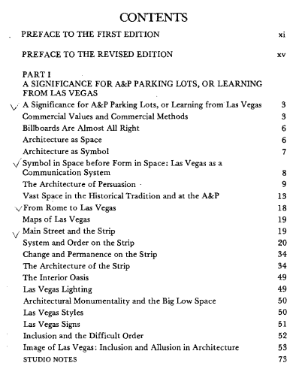
The book is divided into two distinct parts. Part I provides a basic overview of Las Vegas as well as an analysis of individual issues regarding the Strip, its lighting, signs, and order. It is a culmination of library and field research gathered by three professors and thirteen students from the Yale School of Art and Architecture.

Slide 39
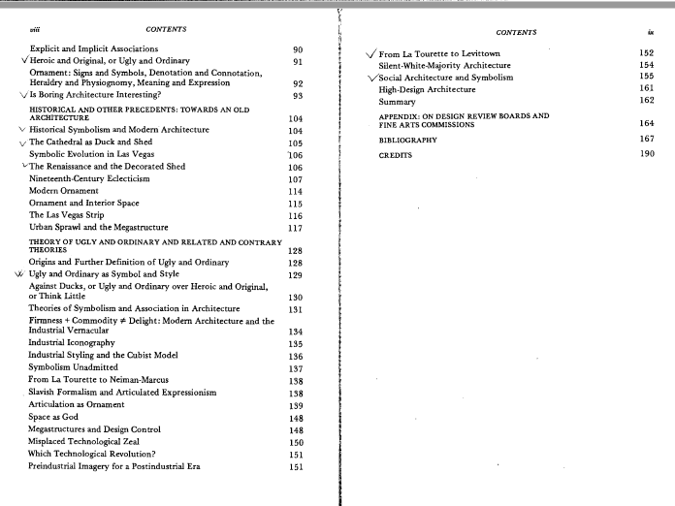
Part II contains the synthesis of their data applied to symbolism in architecture and the iconography of urban sprawl.

Slide 40
In the Words of Denise Scott Brown

Slide 41
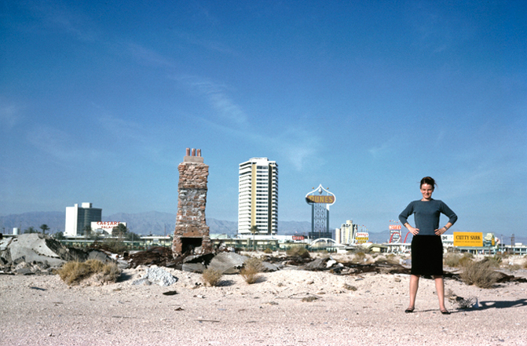
Denise Scott Brown, Las Vegas style and Denise style, 1966. Photo by Robert Venturi.
Denise Scott Brown has learned from many sources. She is a polymath: architect, urban planner, furniture designer, critic, theorist, photographer, filmmaker and DIY anthropologist. Throughout her career, this fact has been poorly acknowledged and certainly under-celebrated. Her professional achievements and innovations have often been accredited to her collaborator and husband Robert Venturi. Learning-from-what's-around-you has remained an overarching theme for Scott Brown.

Slide 42
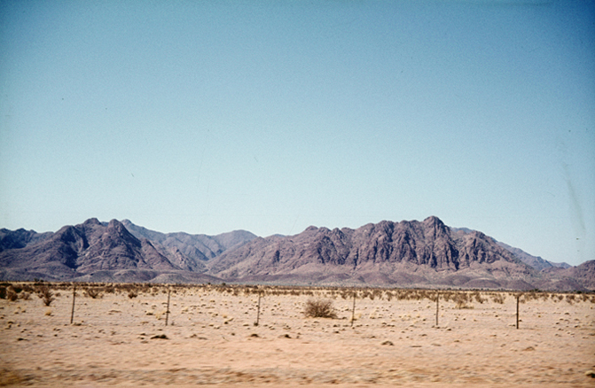
Scott brown drew influences from her South-African background. "It was relatively easy to transfer my African attitude to an American one, suggesting that for the sake of cultural relevance and artistic vitality, American architects look at the landscape around them and learn. In that sense, mine is an African view of Las Vegas. Yet our analyses of the American suburban landscape were based in large part on European modes of scholarly inquiry; we defined the Las Vegas Strip by comparing it with historical European architecture, using categories set up for the study of traditional European urban space."
(http://www.mascontext.com/issues/13-ownership-spring-12/invention-and-tradition/)
Robert and Denise Scott Brown, South Africa Veld, 1957.
Denise Scott Brown, Nevada Desert, 1965.

Slide 43
Robert and Denise Scott Brown, Cape Dutch farm house, 1957.
Robert and Denise Scott Brown, English thatch cottage in Natal Kwa Zulu, 1957.
European colonists took their architecture with them and adapted it to conditions they found in the colonies.
Robert and Denise Scott Brown, Mapoch village houses, 1957.

Slide 44
Growing up in South Africa remained a vivid and important ethnic memory. "Members of my family left Eastern Europe for Africa in the late 19th century. We were ethnics in the wilderness. My mother's parents, living in Zambia and Zimbabwe, started in mud huts, hunting for food, and cooking over outdoor fires. My mother grew up there and spoke some IsiNdebele."
Denise Scott Brown, 2017.

Slide 45
Photograph Denise Scott Brown took in the 50s or 60s in South Africa.
"As an architecture student, I studied South African landscapes and housing and, gaining urban insight, I grew interested in the melding of African folk and white industrial-cultures. And when I saw the outrage of scholars and purists at such divergences from tradition, I gained a taste for studying the shocking... I was involved from childhood in such mixings of cultures in our multicultural country."

Slide 46
Artists were prominent in such cultural mixings. "They were latter-day Impressionists who interpreted rural Africans as the 'noble savage,' a la Gauguin and the Romantic movement. I love their paintings, but I love African depictions of Western life even more...And so my views of Las Vegas were initiated. There was also my discomfort with English expats who, shielding all but a small corner of our beautiful veld from view, said 'that could be a little bit of Surrey!' Why did it have to look like Surrey to be beautiful, I asked, and affirmed my belief that what's considered ugly must nevertheless be examined and understood."
Maggie Laubser, Annie of the Royal Bafokeng, 1945, oil on canvas.

Slide 47
"Then I came to America and studied city planning The social planners admonished us: you architects are so arrogant about what people want.... people stay away in droves from your spaces. You can’t say you're designing a public space. Only public use can make it public, and probably they won’t use yours because you haven't thought hard enough about what they want and need. You give them something you find beautiful, but what’s it worth if they can’t use it? I was their friend and sympathizer, I firmly straddled both camps."
(see interview in Learning from Las Vegas with Denise Scott Brown: The Foundation by Nicholas Korody https://archinect.com/features/article/149970924/learning-from- learning-from-las-vegas-with-denise-scott-brown-part-i-the-foundation)
AA Files 56 (London: Architectural Association Publications, 2007), 64-73.

Slide 48
Bob Venturi was the only member of the architecture faculty who sympathized with Scott Brown's attempts to straddle architecture and planning responsibly.

Slide 49
The Meanings of Architectural Forms

Slide 50
Scott Brown explains:
"The forms we chose for analysis were new and undeniably American. Although scorned by architects as vulgar distortions and malformations of urbanism, they were the quotidian of the landscape; we sensed that they contained important lessons for architecture in the latter part of the twentieth century."
Venturi, Robert, Denise Scott Brown, and Steven Izenour. Learning from Las Vegas. Cambridge: MIT Press, 1977.

Slide 51
Aladdin hotel and sign, 1967.
For example, although architect Martin Stern hated the sign that rivaled with his relatively undecorated building, the owner, Milton Prell, hotel owner and developer, loved it. The sculptural three-dimensional sign topped by a lamp expressed the theme of Aladdin, in which a boy is granted wishes by a genie in a lamp. Like the Dunes, Aladdin took its theme from One Thousand and One Nights (a collection of Middle Eastern folk tales), yet Aladdin’s tale was considered even more appropriate to the Strip.

Slide 52
The Landmark appropriated the sculptural qualities of the sign, 1969.
In 1959, Frank Caroll envisioned the Landmark as more than a simple high rise. "I, as builder, saw Las Vegas as the Promised Land, but in designing a hotel for this city, I had to have something different. I don’t like to build ‘boxes’ for hotels," he said. So his architect, Edward Hendricks, designed a saucer-like dome. The Landmark had a long circular shaft with pie-shaped rooms, topped by a saucer. The three story glass dome contained a casino, lounge, Chinese restaurant, and nightclub. The design mimicked the space-age look that was popular in Los Angeles, and it was rather similar to the 1962 Seattle Space Needle.
Seattle Space Needle, 1962.

Slide 53
Venturi and Scott Brown categorized buildings on the Strip into two opposing semiotic types, the "duck" and the "decorated shed." Roughly speaking, the duck was a building in which the structure was dominated by a larger symbolic form; for instance, a hot dog stand that looked like a hotdog. Modern architecture, dominated by machine and cruise-line aesthetics, was also classified as a duck. The decorated shed was a building on which ornament or information had been applied regardless of the structure underneath.

Slide 54
Venturi and Venturi Brown drew the basic conclusion that all architecture is either what they call a Decorated Shed or a Duck: "the $10,000 building with the $100,000 sign." The other type of architecture, the Duck, is a building that has so reduced itself in importance in comparison to its sign that it has actually become the sign.

Slide 55
According to Venturi and Scott Brown, most modern architecture are basically un-admitted Ducks. The real hypocrisy was that "… modern architecture always demonstrated what it was by setting itself against what it wasn't."

Slide 56
The Dunes sign contained elements of both: its sign a symptom of a decorated shed, while the modernist tower was a typical duck.
The 180-foot Dunes sign started the Pop City era, or the "Golden Age of the Sign."

Slide 57
A true decorated shed was the Stardust casino in which they stayed—it was a type that they aspired to. The Stardust building was plain, shed-like, with signage applied independently from it.

Slide 58
This is what Venturi and Scott Brown saw as a historically new organizing principle of vernacular architecture. For instance, in Baroque, Renaissance, and Gothic architecture, symbolism had been integrated into the building. They carry a surface alive with appliqué ornamental symbols, the function of which is to evoke various emotional responses. This is historical architecture. The decorated shed increasingly separated the gap between the building and the information.
Baroque
Renaissance
Gothic

Slide 59
Existing resorts were forced to upgrade their signs, much to the delight of the sign companies. Ad-Art was particularly successful in winning commissions. In 1967, the company designed the 1967 Frontier sign. Rather than going after sculptural sophistication, it used height to electrify. Standing 184 feet tall, it was the largest sign at the time. An F-logo revolved above its 16-foot tall letters. In 1968, Ad-Art also won the commission for the Stardust and the Flamingo sign. The Stardust sign, a cloud of stars, towering 188 feet above the Strip, was highly popular with the public, who constantly voted it "favorite sign spectacular" of the Strip. The Flamingo sign, replacing the champagne tower, was the tallest single shaft sign on the Strip, feathering out in brilliant pink, at no less than 130 feet.
Looking north on the centre of the Strip, the Dunes, Aladdin, Flamingo, and Bonanza signs.

Slide 60
Scott Brown: "We started our study with investigations of the character of the symbols that could best communicate over the vast space of the American strip; we continued with analyses of the buildings behind the signs and what they could communicate symbolically at different scales."

Slide 61
"Finally, we turned to symbolism at the traditional scale of architecture for pedestrians. Here, ornament and decoration become a major interest."

Slide 62
As such, Learning from Las Vegas:
Challenges the architect to take a nonjudgmental stand in studying new space order
Studies capitalist, commercial vernacular architecture of America in 1972
Learns to infuse high / low culture, the fine / crude art, persuasion / communication into our buildings
Focuses on symbolism and its virtues in the social and cultural fabric (architecture as a communication over space versus form in space)
(Cambridge: MIT Press, 1977)

Slide 63
Each sign Scott Brown and Venturi demonstrate is different, yet they share certain traits; their location, size. Each sign possesses symbols borrowed from another era, and made its own. The architects salute this lack of innovation: What they call "old words with new meanings" are, after all, more in line with clients' value systems.
Evolution of Billboards

Slide 64
Scott Brown and Venturi's main concern is the myopic adoration of great modern architecture, and the extreme under appreciation of commercial architecture.

Slide 65
They cite Le Corbusier's infamous desire to knock down all of Paris and rebuild it again as exactly the sort of attitude they fear from architects.
Le Corbusier, Plan Voisin, 1921.

Slide 66
Le Corbusier wanted to replace this what he considered an urban blight with something incredible. Plan Voisin called for 18 cruciform glass office towers, placed on a rectangular grid in an enormous park-like green space, with triple-tiered pedestrian malls with stepped terraces placed intermittently between them. Extending perpendicularly to the west, there would be an adjacent rectangle of low-rise residential, governmental, and cultural buildings amid more green space. The new development would be integrated with highways, train and subway lines, as well as an airport, making this area the first thing that most visitors to the city would see.
Le Corbusier, Plan Voisin, 1921.

Slide 67
In contrast to LeCorbusier, Venturi and Scott Brown champion architecture based on style and image, on folk or vernacular construction, and "architecture without architects." This vernacular style should be, by historical precedent, absolutely laden with signs and symbols from other eras and our own, it should mix high and low art, the sacred and the putrefying, for this they say is our natural language.

Slide 68
Within this context Las Vegas is studied as heightened example of architectural persuasion with a combination of forms, styles, both architecture and landscape, where the strip embodies the difficulty of inclusion rather than the easy unity in exclusion.

Slide 69
"There is a contrast between the two types of order on the Las Vegas Strip: the obvious visual order of the street elements and the difficult visual order of the buildings and signs. The zone of the highway is a shared order. The zone off the highway is an individual order. The elements of the highway are civic. The buildings and signs are private."

Slide 70
The architecture along Main Street and The Strip doesn't define the city. Las Vegas is dominated by the bold neon signs that advertise the numerous entertainment sites. These signs, often independent of the buildings themselves, are visually powerful and unmissable to those passing on the highways. The harsh visual order of the signs in contrast to the order of street elements is discussed in Learning from Las Vegas and the importance of the sign is heavily emphasized throughout.

Slide 71
The long vast highways between the buildings demonstrate the change in urban planning during the 20th century. This was a result of the introduction of the automobile which marked a revolutionary change. The advancement of machinery processes meant productivity and consumption continued to grow since the first introduction of the first automobile in the 1920’s. The twentieth century was now characterised as a "society obsessed with speed and efficiency." The high speed fluidity of the Las Vegas landscape meant that the either the signs or buildings had to be striking. Signs advertise and communicate a complexity of meanings, in a few seconds from far away. Without the symbolism of the signs, the architecture itself wouldn't communicate.
Venturi and others, Map of Las Vegas Strip showing written words seen from the road, Learning from Las Vegas, 30.

Slide 72
From Rome to Las Vegas, 1968.
Venturi and Scott Brown likened Las Vegas to the Roman piazza. In Rome, every road leads to the inevitable piazza—a void in the congested city. In Vegas, every road leads to the Strip—a void with no focus, in an open, indefinite space. Only the scale has changed, from a space for pedestrians to one for automobiles. The Renaissance piazza was heavily ornamented with mixed- media symbols borrowed from other eras. Similarly, the billboards that line the highways of Vegas, inspired from the Roman triumphal arch are architecture as propaganda, meant to be read at 55 m.p.h.

Slide 73
Rome, every architect's pièce de resistance... Venturi and Scott Brown call this critical associative process in Learning from Las Vegas, "From Rome to Vegas and back to Rome again."

Slide 74
Denise Scott Brown, Architettura Minore on the Strip, Las Vegas, 1966.
Las Vegas was the city to which Scott Brown first was drawn. Her interest in it coincided with her work in California, during her tenure as co-chair of the Urban Design Program at the University of California, Los Angeles, in the mid 1960s. Like Los Angeles, Las Vegas was uniquely bound to the North American phantasmagoria: a city of neon lights and elevated signs, of freeways and parking lots, of 24-hour casinos and nocturnal transformations, of constant kino- graphic communication.

Slide 75
In her 1969 essay "Learning from Pop," she wrote, "space is not the most important constituent of suburban form. Communication across space is more important, and it requires a symbolic and a time element in its descriptive systems which are now only slowly being devised." Las Vegas was the city she had invited Robert Venturi to walk around with her in 1966. It was the city to which they returned numerous times to develop the site-responsive methodology they taught at Yale and it filtered, too, into their own inimitable architectural style over the following decades, combining modular forms with unique, location-specific decorative orders.
Denise Scott Brown, “On Pop Art, Permissiveness, and Planning,” AIP Journal, 35 (May 1969), 184-6.
(reprinted in London: Architectural Association, 2009)

Slide 76
The artist Edward Ruscha was a major influence on Scott Brown and later Venturi. In the mid- 1960s Scott Brown discovered Ruscha's work when she was in Los Angeles.
Edward Ruseha, Twenty-Six Gasoline Stations, 1963.

Slide 77
During this time, she was creating her own photographic archive of vernacular architecture in the area.
Scott Brown, Pico Boulevard, Santa Monica, California, 1966 /Industrial Romanticism, Los Angeles, 1966.

Slide 78
Venturi and Scott Brown’s Learning from Las Vegas shares Ruscha's approach to images that is almost anthropological in its spare, non-judgmental rendering of previously unnoticed elements of the urban experience. In Learning from Las Vegas, Venturi and Scott Brown produced a two- page spread that imitates Ruscha’s Sunset Strip pictures. A series of photos taken by a camera mounted on a pickup truck display without comment the entire length of both sides of the Las Vegas strip.
Venturi, Robert, Denise Scott Brown, and Steven Izenour. Learning from Las Vegas. Cambridge: MIT Press, 1977.

Slide 79
Ruscha explains his approach: "Los Angeles to me is like a series of store-front planes that are all vertical from the street, and there’s almost like nothing behind the facades...It’s all facades here—that’s what intrigues me about the whole city of Los Angeles—the facade-ness of the whole thing..."
Edward Ruscha, 6565 Fountain Avenue in Some Los Angeles Apartments, 1965.

Slide 80
Edward Ruscha, Some Los Angeles Apartments, 1965.
Such images demonstrate a shared interest in the symbolic nature of building fronts, one which operates at the foundation of many of Venturi and Scott Brown’s ideas and designs.

Slide 81
In a 2013 interview at the Tate Gallery Ruscha talked about his photographic book on parking lots: "Parking lots came about almost by accident and I had an opportunity to go up in a helicopter above LA. And so, I went with a friend of mine and a pilot and we did the entire city in like 45 minutes. I began to really notice swimming pools and parking lots, two elements of the city that really impressed me. I liked it just for the study of it and it just spoke back to me, you know, it had some kind of value to me as to making a work of art. Seeing the top side of something instead of necessarily looking directly on like this, base line perspective, so looking over the top of something sort of allows for more view, a lot to do with perspective and the fact that things diminish and come into the foreground and so it’s all those elements that come together that... attract me to it."
Edward Ruscha, Los Angeles: [Self-published], 1967.

Slide 82
A Schedule of Las Vegas Strip hotels:
plans and sections and elements in Learning from Las Vegas

Slide 83
Scott Brown recalls: "For 1960s students, only a rebellious artistry would intrigue. It had to 'blow the minds of the citizens.' We agreed. And if our aim to widen their view of architecture called for a measure of rebellion, so be it. It would be fun. Voila Las Vegas!"
(https://archinect.com/features/article/149977368/learning-from-learning-from-las-vegas-in- conversation-with-denise-scott-brown-part-3-research)
Departing from formalistic studies of individual objects, the studio shifted the focus to the layout and appearance of the suburban, car-oriented landscape of "urban sprawl." Izenour particularly stressed the need for devising new techniques of visual representation for new urban forms.

Slide 84
Situated at the disciplinary divide between architecture and urban planning, it sought to analyze and chart the form of the contemporary city, while at the same time addressing the consequences of the findings for architectural design. Moreover, the studio departed from the traditional design studio to make research the main focus of investigation. A large part of the semester program was taken up by library research and a field trip to Los Angeles and Las Vegas. To this end, the research group experimented with a variety of visual media. In addition to relatively conventional media such as maps and charts, photography and film took a prominent part in this investigation. By mounting a camera on the hood of a car and driving along the Las Vegas Strip (a technique borrowed from artist Ed Ruscha), the group recorded a "deadpan" image of the city.

Slide 85
Venturi, Scott Brown, and John Rauch, Buildings Reflecting Learning from Las Vegas

Slide 86
Closely related to a Thunderbird in Las Vegas in its enlarged lettering, the building for Basco Products is a simple box with a relatively monochromatic facade. Enormous letters dominate the building and effectively advertise the company’s identity within its commercial environment. These forms, though actually detached from the structure, are visually connected to the building and gain meaning as a group only against its blue backdrop. From the road, the facade reads as a continuous surface.
Thunderbird Hotel, Las Vegas, 1964.
Venturi and Rauch, Basco Building, Philadelphia, 1979.

Slide 87
Edward Ruscha, HONK, 1962.
Ed Ruscha, Annie, 1962.
The architects’ solution seems not unrelated to Ruscha’s word images, the graphic compositions they created to document the Basco project utilize techniques from both Ruscha’s paintings.

Slide 88
Here are some more examples of buildings designed by Venturi, Scott Brown and John Rauch.
One of Venturi and Scott Brown’s early projects was Fire Station #4 in Columbus, Indiana. The 1968 building is sheathed in red and white-glazed brick and comprises storage and living quarters, a space for fire trucks, and a hose tower. The building, the handling of the proportions of the Fire Station gives the little building big scale in its setting—a vast, flat field along a straight highway.
Venturi, Scott Brown and Rauch, Fire Station, No. 4, Columbus, Ohio, 1966.

Slide 89
The Vanna Venturi House is considered one of the earliest examples of postmodern architecture. Its design explores classic forms and plays with symmetry and scale, serving as a realization of the ideas put forth in Venturi’s 1966 book, Complexity and Contradiction in Architecture.
Vanna Venturi House, Chestnut Hill, Pennsylvania, in 1964.
(Museum of Modern Art, 1966)
As Charles Jencks wrote in Architectural Record, 2016: "Venturi pushed for complexity in architecture instead of Modernism’s generic and simple solutions."

Slide 90
The vibrant structure of the Children’s Museum of Houston features playful interpretations of classical architecture, with a combination of flexible spaces and room for permanent exhibitions, plus classrooms, an auditorium, an art studio, offices, and a gift shop.
Venturi, Scott Brown and Associates in collaboration with Jackson & Ryan Architects on the Children’s Museum of Houston,1992.

Slide 91
The new façade in Museum of Contemporary Art San Diego references the architecture of the historic Scripps House, the museum’s home since 1941. Within the new exterior is a dramatic lobby with a star-shaped clerestory window.
Venturi and Brown and David Singer, Museum of Contemporary Art, San Diego, 1996.

Slide 92
Learning from Las Vegas and Pop Artists

Slide 93
Scott Brown came to the United States via London, where she studied from 1952-1955 at the Architectural Association (AA). There, Scott Brown learned from (among others) Alison and Peter Smithson, the wife-and-husband architect team who were leading members of the avant-garde art Independent Group (IG).The Smithsons designed the House of the Future for the Daily Mail Ideal Home Exhibition. The house was never intended for actual production but for theoretical discussion. Designed around a courtyard garden that supplied natural lighting and private outdoor space, there were few windows on the exterior walls allowing the houses to be placed directly side-by-side. For viewing purposes, there was no roof but an elevated platform so exhibition goers could look inside the house from above. Appliances and work areas were hidden from view within cubicles allowing for a large open space in which to live.
Unknown photographer, Interior view of the House of the Future looking down from the viewing platform, Daily Mail Ideal Home Exhibition, London, March 1956.

Slide 94
The IG was steeped in Dada, comic books, American advertisements, and science fiction. At its first meeting in April 1952,Eduardo Paolozzi fed colourful images—advertising, comic strips and assorted graphics—from American magazines through an epidiascope. The artists seminal 1947 collage I was a Rich Man's Plaything was the first such "found object" material to contain he word "pop" and is considered the initial standard bearer of "Pop Art." The IG was responsible for formulation, discussion and dissemination of many of the basic ideas of British pop art and new British art in the late 1950s and early 1960s. Design critic and historian, Reyner Banham, already mentioned above, was a leading member of IG.
Sir Eduardo Paolozzi, I was a Rich Man's Plaything, 1947.

Slide 95
From the IG also came the early pop art of Richard Hamilton. "Pop art" the British artist declared, would be: "Popular, transient, expendable, low-cost, mass-produced, young, witty, sexy, gimmicky, glamorous, and Big Business." Speaking of his motivation behind creating this collage, Hamilton stated, "The objective here was to throw into the cramped space of a living room some representation of all the objects and ideas crowding into our post-war consciousness."
Richard Hamilton, Just What Is It That Makes Today's Homes So Different, So Appealing? The 1956 collage is often referred to as the first example of Pop Art.

Slide 96
Thus, Scott Brown was one of the first architects / designers to acknowledge the significance of Pop Art as a means of understanding the American vernacular and the commercial strip. "We can learn...from Las Vegas as have other artists from their own profane and stylistic sources," Scott Brown and Venturi wrote. The architect pair would draw from Andy Warhol's painted Campbell’s soup cans and Warhol’s famous works, Marilyn Diptych, 1962, which uses an image of Marilyn Monroe taken from the popular film Niagara (1953).
Andy Warhol, Campbell’s Soup Cans, 1962.
Andy Warhol, Marilyn Diptych, 1962.

Slide 97
Emerging in the late 1960s, Pop artists focused on the symbolism of the everyday American culture. The use of commercialized images, products, films and celebrities represented a radical break from traditional subject matter. The underlying concepts of the mass culture that defined the Pop artists were heightened by the new approaches to techniques and style. Traditional painting techniques were replaced by cheap commercial techniques that allowed the images to be reproduced multiple times.
Niagara, 1953

Slide 98
Scott Brown and Venturi clearly understood the relevance of Pop artist's Claes Oldenburg's sculptures to Las Vegas the commercial vernacular. In the introductory notes for the "Remedial Housing for Architects" Studio course, Scott Brown outlines the final research topic: "The Oldenburg Interpretation," whose task reinforces the architects' views that successful symbolism involves an innovative representation of the familiar and that a non-judgmental approach facilitates a renewed understanding of the contemporary urban environment.
Claes Oldenburg, Floor Burger, 1962.

Slide 99
Claes Oldenburg, Two Cheeseburgers, with Everything (Dual Hamburgers.) 1962.
Scott directs her students to Do for housing what Oldenburg has done for hamburgers and explains: "Oldenburg has essentially made us look at hamburgers in another way because he has portrayed them in an unusual way: big, lacquered, and in an art gallery. Does he hate them or love them and should we? Probably he feels some of both, but that doesn’t matter—at least not yet. The first thing is the shift in vision and understanding which an Oldenburg can induce, and the reinterpretation and reclassification of our cultural artifacts which he provides."

Slide 100
For Venturi and Scott Brown, Las Vegas provided stimulating examples of a symbolic architecture in opposition to the formalism of the modernists. Likewise, Oldenburg created a symbolic sculpture tied to social and artistic messages that took a stance against artistic formalisms.
(University of California Press, 2021, p. 125)
Notes:
(University of California Press, 2021)

Slide 101
Learning from Las Vegas has had massive implications. Scott Brown and Venturi’s book identified Las Vegas as the city of postmodernism. Postmodern architects around the world happily learned from Las Vegas resorts’ playful and lavish quotations from the past and other places. "America has become Las Vegasized," declared Time at the peak of postmodernism in the 1990s, two decades after the book’s publication. Thanks to Scott Brown and Robert Venturi, elite architects would no longer flinch at a faux column or architrave.
January, 1994.

Slide 102
Scott Brown and Venturi were having a grand old time enumerating the freakish architectural mini-movements that had emerged, from "Miami Moroccan, International Jet Set Style" to "Yamasaki Bernini cum Roman Orgiastic" to "Bauhaus Hawaiian." More than four decades on, anyone setting foot on the Strip will soon realize—with relief or horror—that nobody remotely describable as a "tastemaker" has yet taken over. The place has, if anything, gone much further over the top, presenting visitors with streetside spectacles unthinkable in the era that Venturi, Scott Brown, and Izenour were writing about.

Slide 103
Still, much remains as it ever was in this arrangement of, as Hal Rothman put it in his history of Las Vegas, Neon Metropolis, "little city-states, interrelated little kingdoms, entirely self- contained and at war for customers. Enter any one of them, and you still contend with what Learning from Las Vegas calls the "intricate maze" that "disorients the occupant in space and time. One loses track of where one is and when it is. Time is limitless, because the light of noon and midnight are exactly the same. Space is limitless, because the artificial light obscures rather than defines its boundaries."
(Routledge, 2015)

Slide 104
But perhaps the most noticeable difference between today’s Strip and the one from which Venturi, Brown, and Izenour learned is in its relationship with cars. In the early 70s, they described casinos surrounded not by literal lakes, full of fountains and gondolas and what have you, but by lakes of parking. "In the old Las Vegas, nobody walked anywhere," writes Rothman, whereas by the 21st century, the Strip had become a promenade: "one created not by planners but by the feet of thousands. Every day, tens of thousands stroll the Strip and drink in the spectacle."

Slide 105
Learning from Las Vegas Bibliography
Al, Stefan Johannes. The Strip: Las Vegas and the Symbolic Destruction of Spectacle. PhD dissertation. University of California, Berkeley, 2010.
Al, Stefan. “Welcome to Theoretical Las Vegas.” Berkeley Planning Journal 22 no. 1 (2009): 141-145.
Atwood, Charles, and David M. Schwarz. Learning in Las Vegas. Edited by Nina Rappaport, Brook Denison, and Nicholas Hanna. New Haven: Yale School of Architecture, 2010.
Banham, Reyner. The Architecture of the Well-tempered Environment. London Architectural Press, 1969.
Banham, Reyner. Theory and Design in the First Machine Age. MIT Press, 1960.
Bookstein, Ezra. The Smith Tapes: Lost Interviews with Rock Starts & Icons 1969-1972. Chronicle Books, 2015.
Brown, Denise Scott. “On Pop Art, Permissiveness, and Planning,” AIP Journal, 35 (May 1969), 184-6.
Burris, Jennifer. "The "Urban Photogénie" of 'Architainment'." Journal of Aesthetics and Art Criticism 69, no. 1 (2011): 93-103.
Denise Scott Brown, and Robert Venturi. "Interview with Denise Scott Brown and Robert Venturi: Is and Ought." Perspecta, 41, Grand Tour (2008): 36-41.
Eisenschmidt, Alexander. "The City's Architectural Project: From Formless City to Forms of Architecture." Architectural Design 82, no. 5 (September 2012): 18-25.
Golec, Michael. " 'Doing It Deadpan': Venturi, Scott Brown and Izenour's Learning from Las Vegas." Visible Language 37, no. 3 (2003): 266-287.

Slide 106
Golec, Michael, and Aron Vinegar. "Instruction and Provocation, or Relearning from Las Vegas." Visible Language 37, no. 3 (2003): 244-247.
Harcourt, Glenn. "Las Vegas Studio: Images from the Archives of Robert Venturi and Denise Scott Brown: Museum of Contemporary Art at the Pacific Design Center, Los Angeles, CA." X-Tra: Contemporary Art Quarterly 13, no. 2 (Winter 2010): 30-39. http://x-traonline.org/article/las-vegas-studio-images-from-the-archives-of-robert-venturi-and-denise-scott-brown/
Harteveld, Maurice and Denise Scott Brown, “On Public Interior Space,” AA Files 56 (London: Architectural Association Publications, 2007), 64-73.
Kong, Mario Andre Sampaio. Re: Learning from Las Vegas: Between Digital and Urban Space. MA dissertation. \ Royal College of Art, 2013. Leach, Andrew. "Leaving Las Vegas, Again." Grey Room no. 61 (Fall 2015): 6-33.
Martin, Reinhold. "Architecture's Image Problem: Have We Ever Been Postmodern?" Grey Room no. 22 (Winter 2006): 6-29.
M'Closkey, Karen. "Signs of Life: Las Vegas." Journal of Architectural Education 64, no. 1 (September 2010): 21-33.
Mille, Raoul. Sarah Bernhardt et Monaco. Du Rocher, 2006.
Rothman, Hal. Neon Metropolis: How Las Vegas Started the Twenty-First Century. Routledge, 2015.
Ruscha, Edward. Thirty-Four Parking Lots. Los Angeles: Edward Ruscha, 1967.
Sheerbart, Paul. Glass Architecture. New York: Praeger, 1972, original publication, 1914.
Scheerbart, Paul. Glass! Love!! Perpetual Motion!!! A Paul Scheerbart Reader. Edited by Josiah McElheny and Christine Burgin. New York City: Christine Burgin Gallery; Chicago: University of Chicago Press, 2014.

Slide 107
Smith, Katherine Anne. Sign Language: Pop Art, Vernacular Architecture, and the American Landscape. PhD dissertation. New York University, 2003.
Smith, Katherine. The Accidental Possibilities of the City: Claes Oldenburg's Urbanism in Postwar America. University of California Press, 2021.
Venturi, Robert. Complexity and Contradiction in Architecture. Museum of Modern Art, 1966.
Venturi, Robert, Denise Scott Brown, and Steven Izenour. Learning from Las Vegas. Cambridge: MIT Press, 1977.
Verebes, Tom. "Towards a Distinctive Urbanism: An Interview with Kenneth Frampton." Architectural Design 85, no. 6 (2015): 24-31.
Vinegar, Aron. I am a Monument: On Learning from Las Vegas. Cambridge: MIT Press, 2008.
Vinegar, Aron, and Michael J. Golec, eds. Relearning from Las Vegas.. Minneapolis: University of Minnesota Press, 2009.
Vinegar, Aron. "Skepticism and the Ordinary: From Norton to Las Vegas." Visible Language 37, no. 3 (2003): 288-311.
Whiteley, Nigel. "Learning from Las Vegas. . . and Los Angeles and Reyner Banham." Visible Language 37, no. 3 (2003): 314-330.
Whiteley, Nigel. Reyner Banham : Historian of the Immediate Future. MIT Press, 2002.
Weingarten, Marc. Who’s Afraid of Tom Wolfe?: How New Journalism Rewrote the World. Autum Press, 2005.
Wolfe, Tom. The New Journalism. Edited by Tom Wolfe and E. W. Johnson. Harper & Row, 1973.

